Slide 1
Status Report: Miami Lib Finder
Miami Lib Finder Team Sept. 25

Slide 2
Overview
This week
Meeting with Benzing (client) 9/26 5pm
Reading research about navigation algorithm

Slide 3
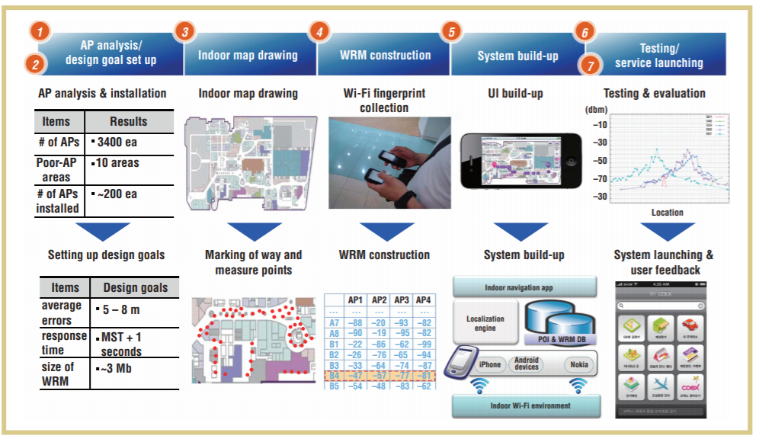
Diagram of Locating

Slide 4
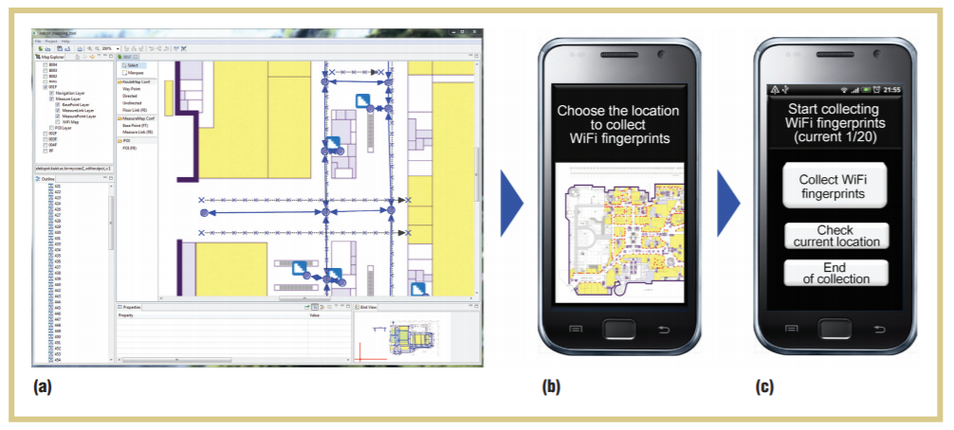
Map Drawing

Slide 5
Citation
Title: Building a Practical Wi-Fi-Based Indoor Navigation System
URL: https://ieeexplore.ieee.org/abstract/document/6818497
Citation: D. Han, S. Jung, M. Lee and G. Yoon, "Building a Practical Wi-Fi-Based Indoor Navigation System," in IEEE Pervasive Computing, vol. 13, no.2, pp. 72-79, Apr.-June. 2014.doi: 10.1109/MPRV.2014.24
keywords: {indoor radio; wireless LAN; Wi-Fi-based indoor navigation
system; COEX complex; Seoul; Korea; IEEE 802.11Standards; Fingerprint
recognition; Navigation; Engines; Smart phones; Indoor communication;
indoor positioning; indoor navigation; location-based service; pervasive
computing},

